Slide 1
Introduction to Information Communication Technology - ICT
Lecture 1
Instructor: Riaz Ul Haq

Slide 2
Course Name: | Introduction to Information and Communication Technologies
Code: CS1123 Credit Hours: | SS1423
 | 3 (2+1)
Pre-requisite: | None
Course Outline:
Basic Definitions & Concepts, Hardware: Computer Systems & Components. Storage Devices, Number Systems, Software: Operating Systems,
Programming and Application Software, Introduction to Programming, Databases and Information Systems, Networks, Data Communication,
The Internet: Browsers and Search Engines. Email, Collaborative Computing and Social Networking. E-Commerce, IT Security and other issues, Project Week, Review Week
Reference Materials:
Introduction to Computers 6th International Edition, Peter, N. McGraw-Hill
Using Information Technology: A Practical Introduction to Computer & Communications, 6th Edition. Williams, S. McGraw-Hills.
Computers, Communications & information: A user's introduction, Sarah, E. Hutchinson. Stacey, C. Swayer.
Fundamentals of Information Technology, Alexis L Mathewsleon Leon Press.

Slide 3
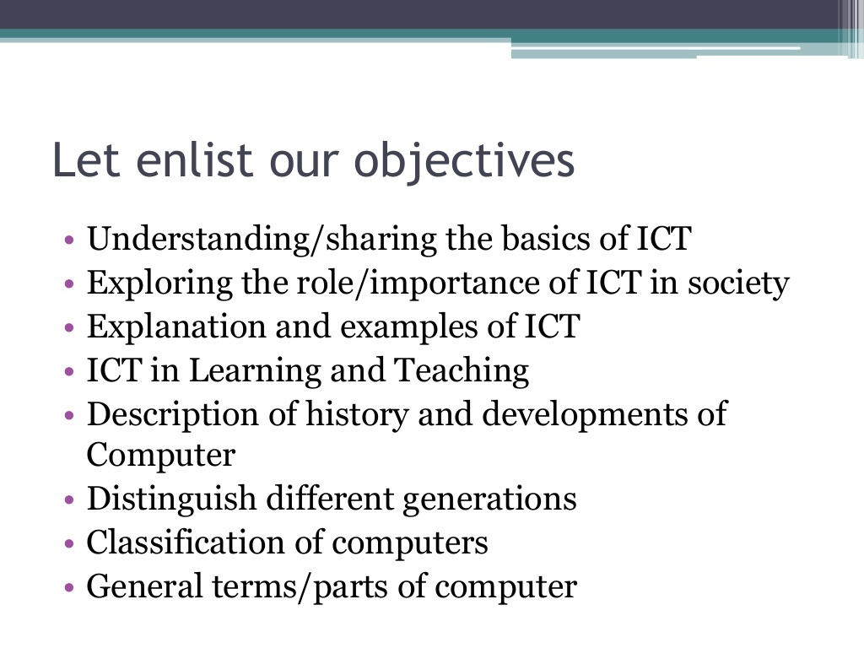

Slide 4
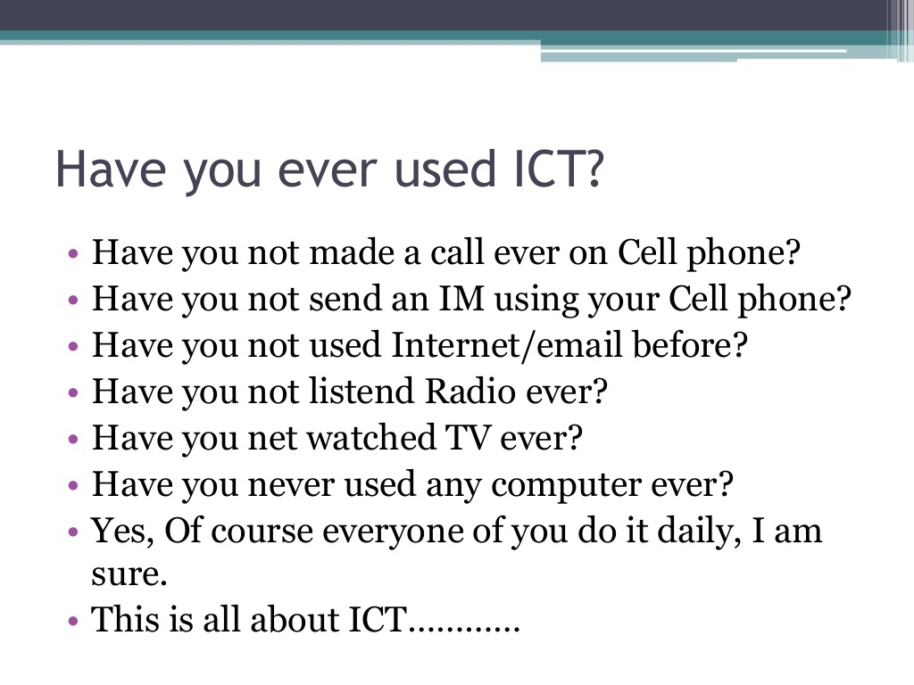

Slide 5
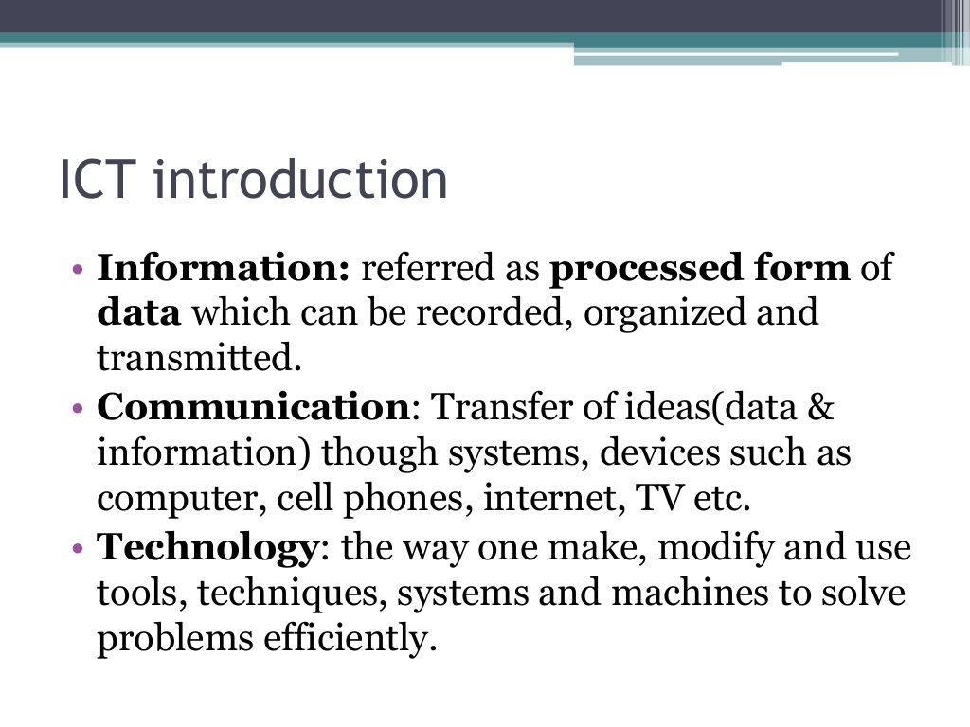

Slide 6
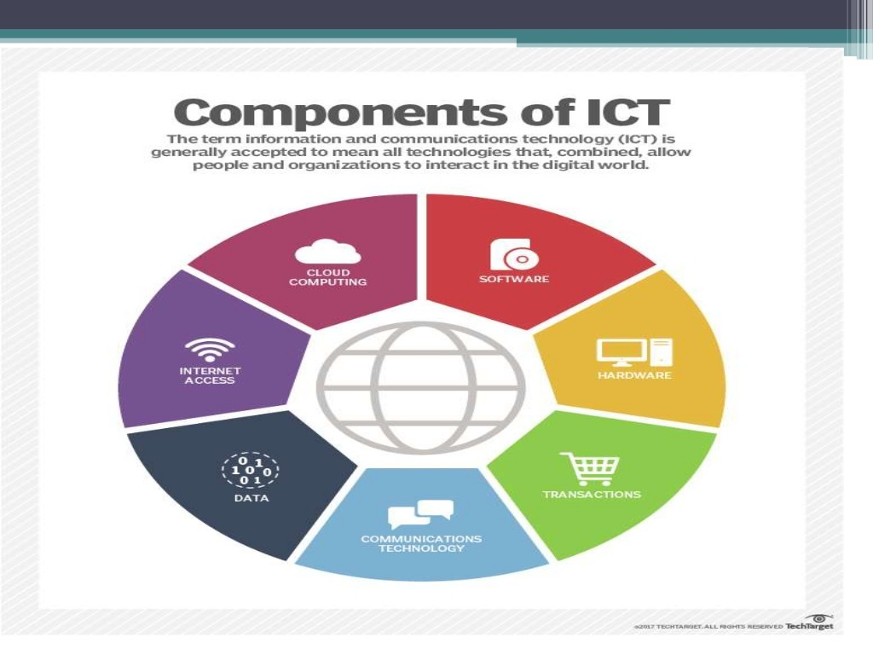

Slide 7
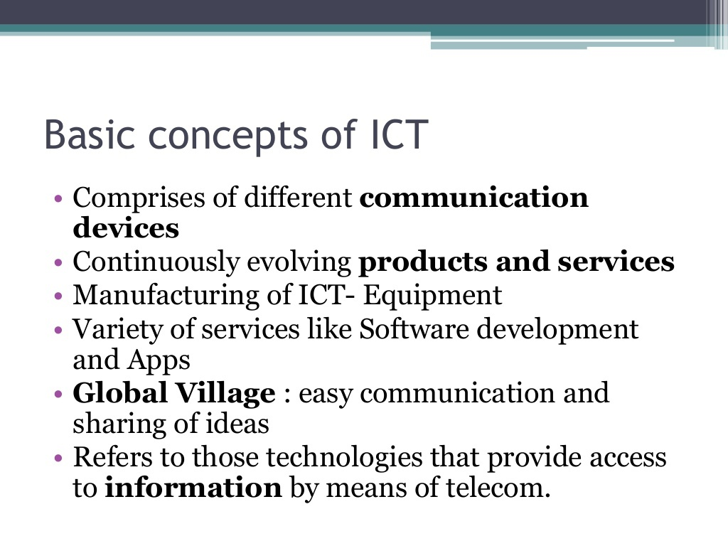

Slide 8
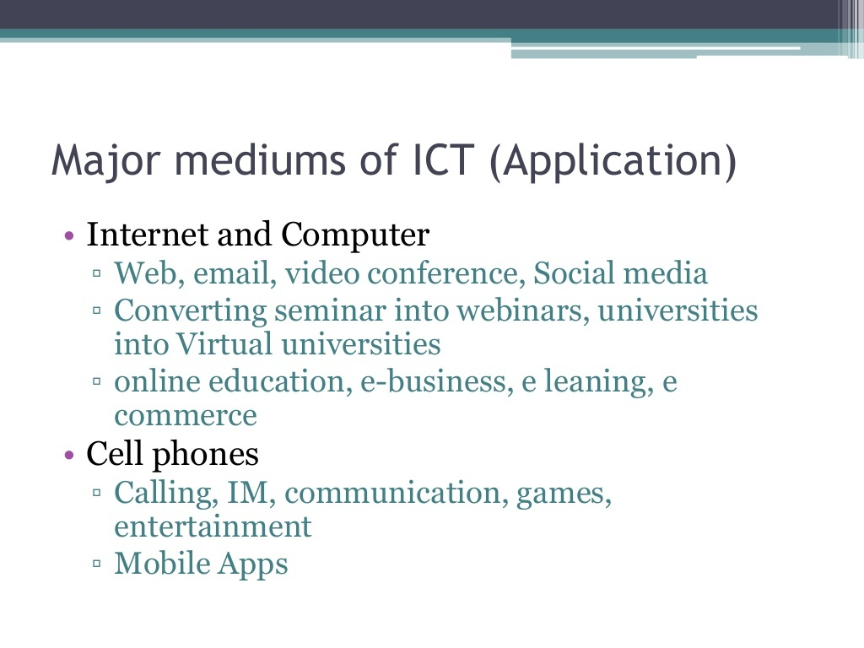

Slide 9
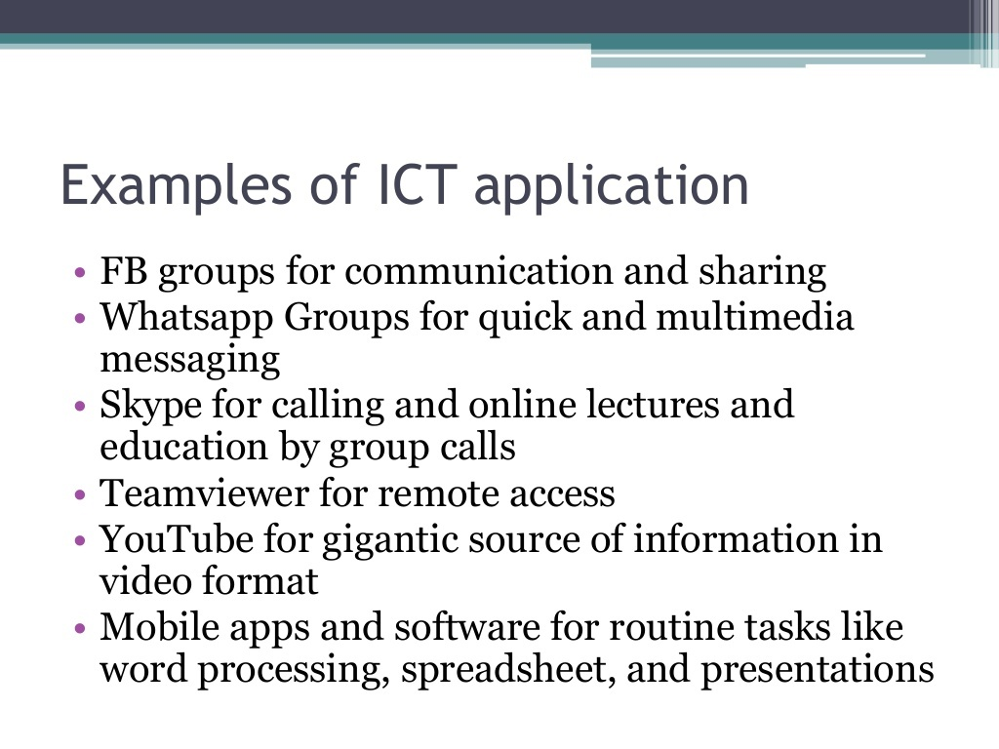

Slide 10
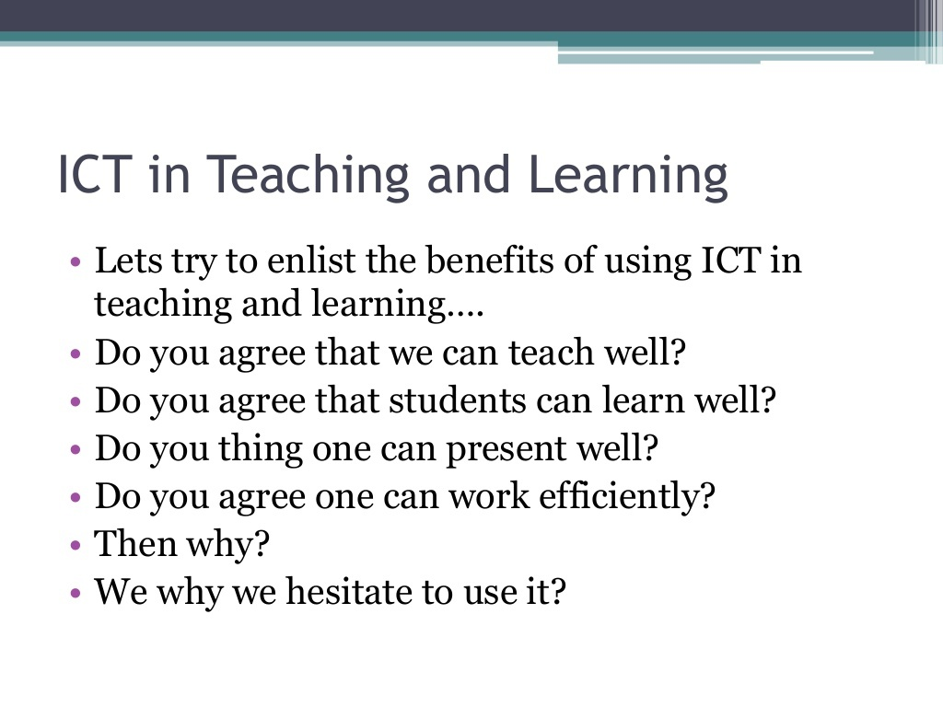

Slide 11
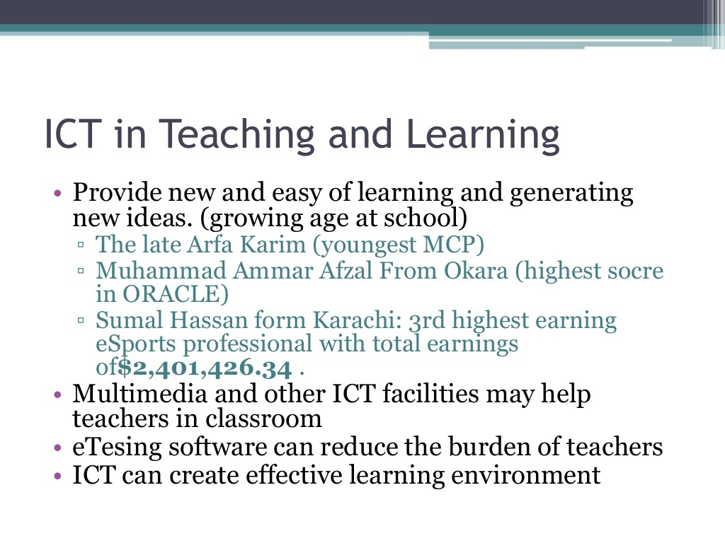

Slide 12
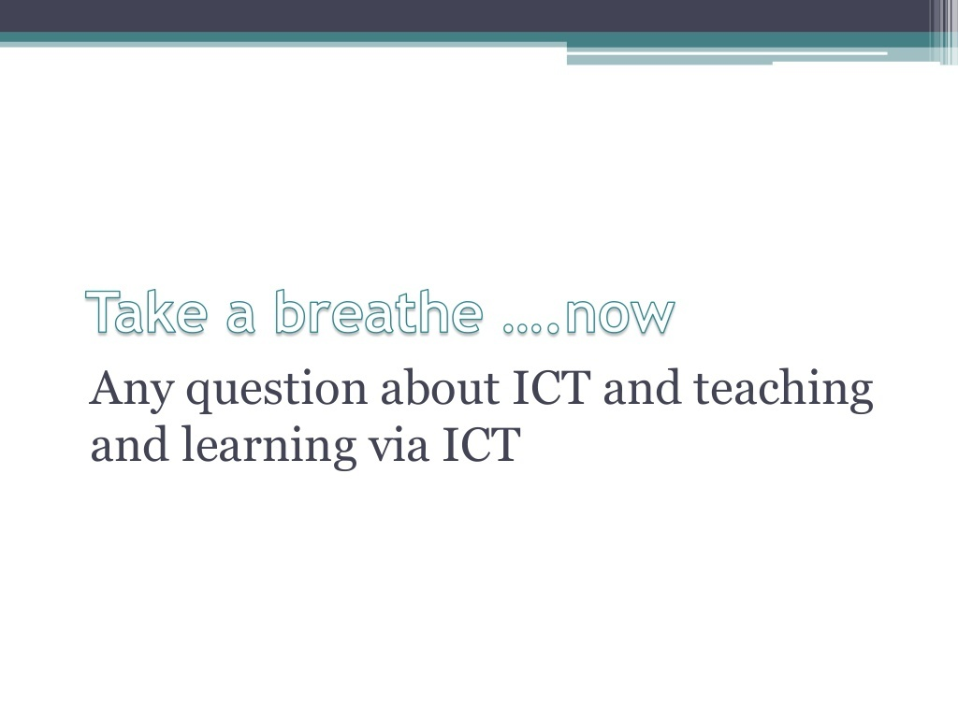

Slide 13
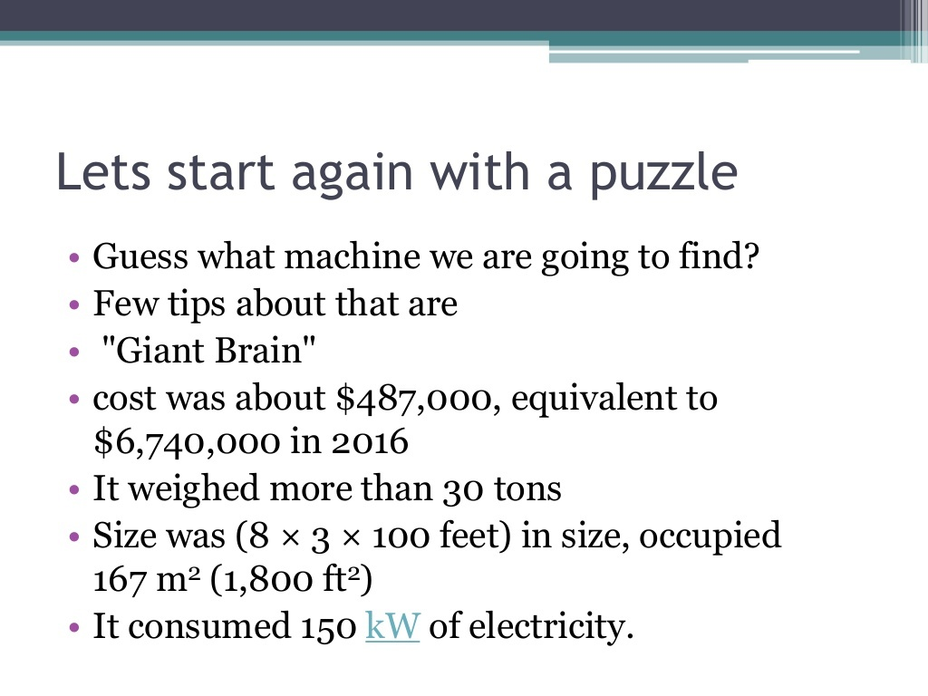

Slide 14
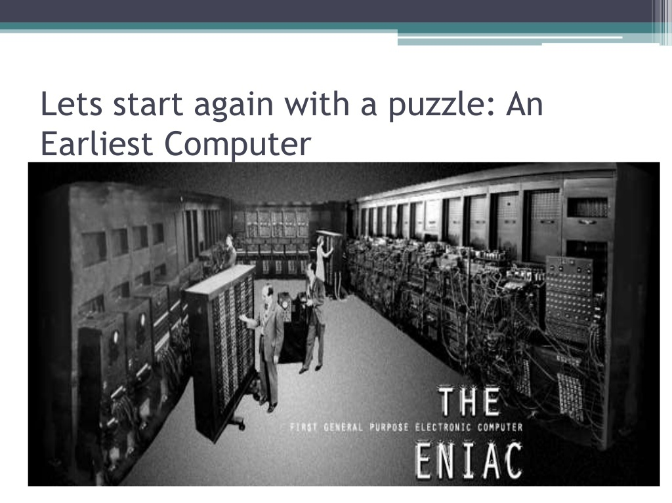

Slide 15
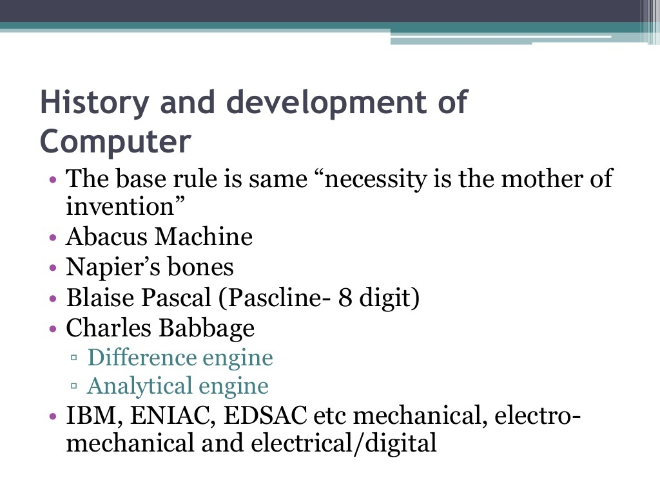

Slide 16
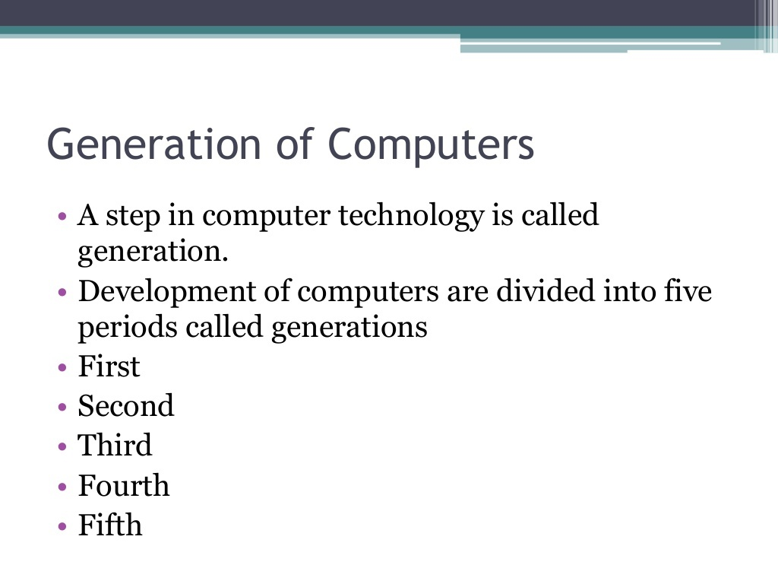

Slide 17
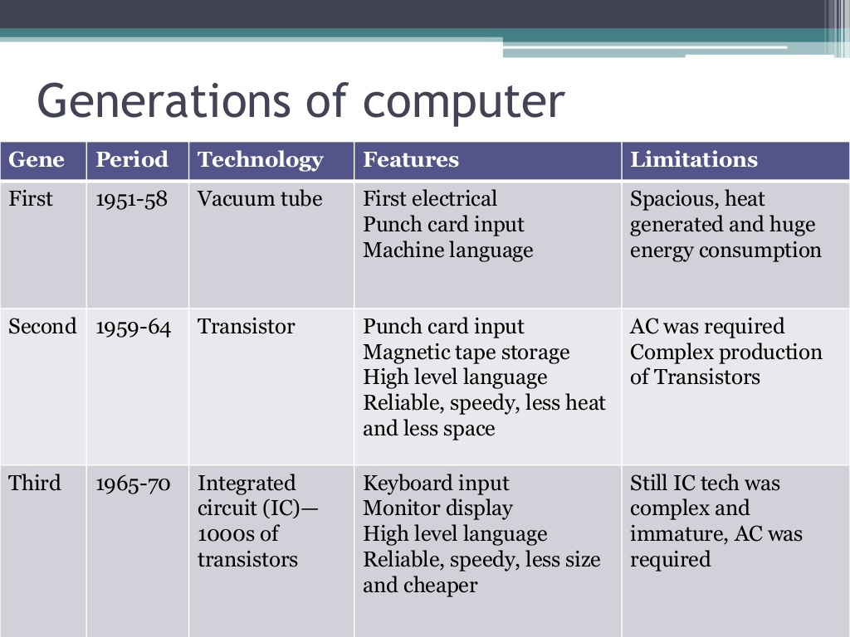

Slide 18
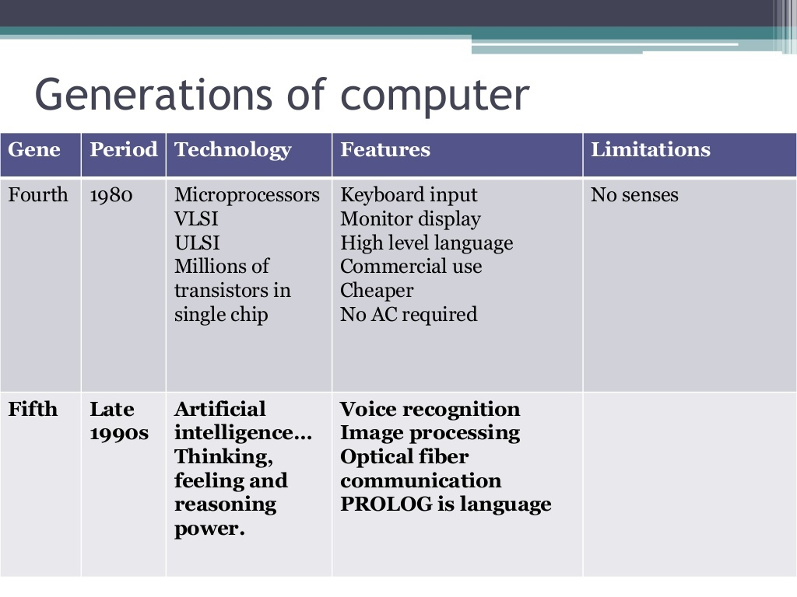

Slide 19
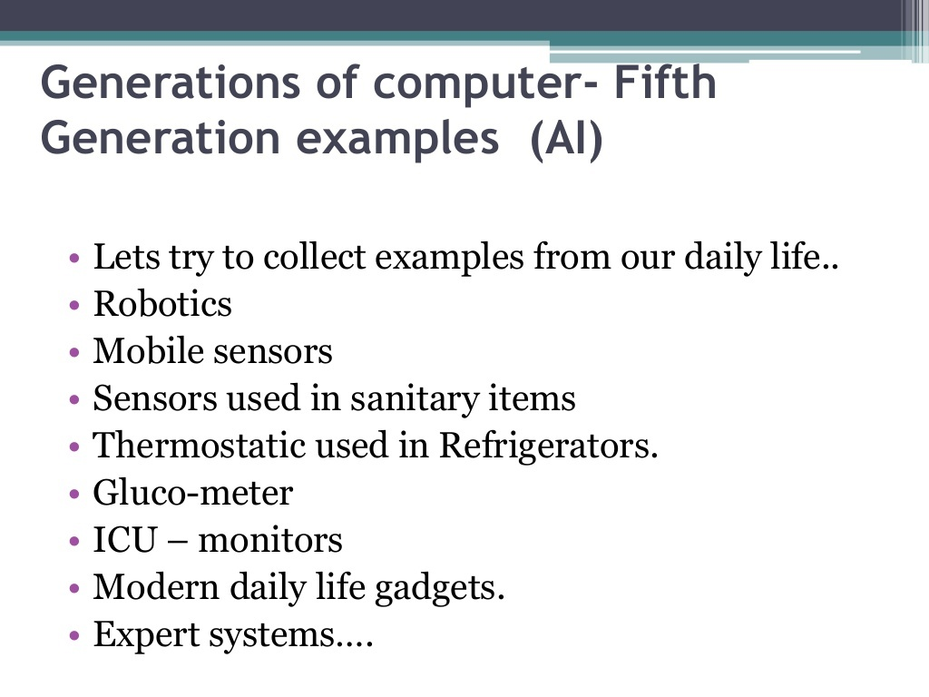

Slide 20
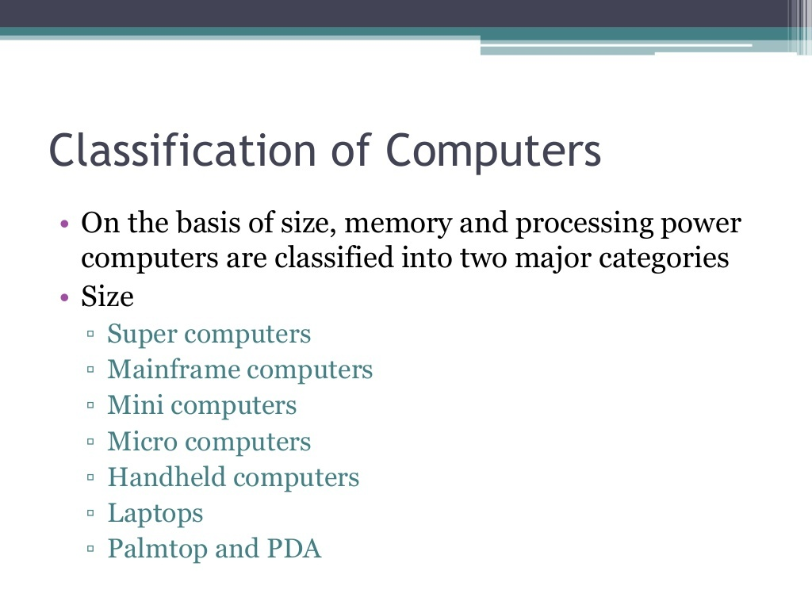

Slide 21
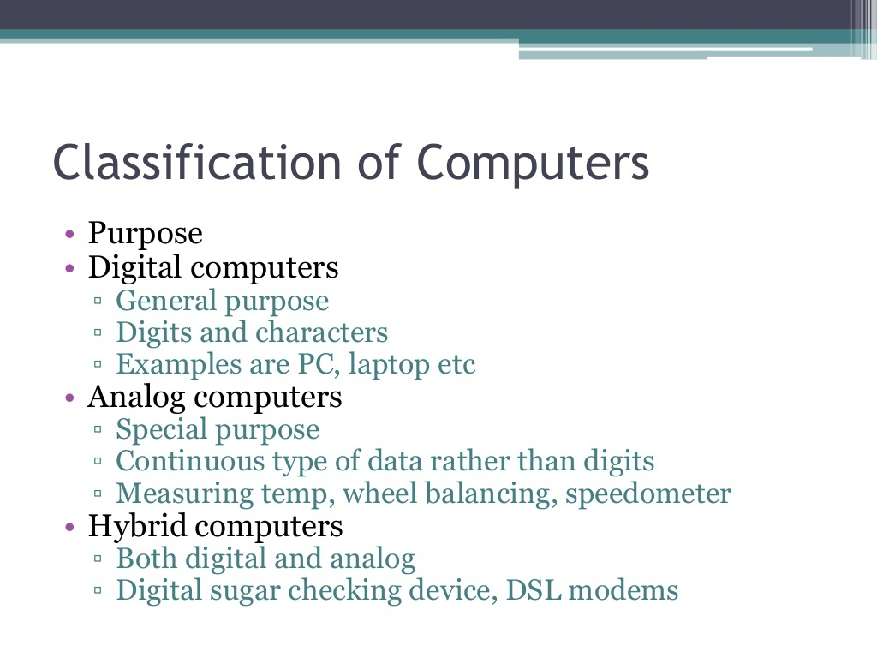

Slide 22
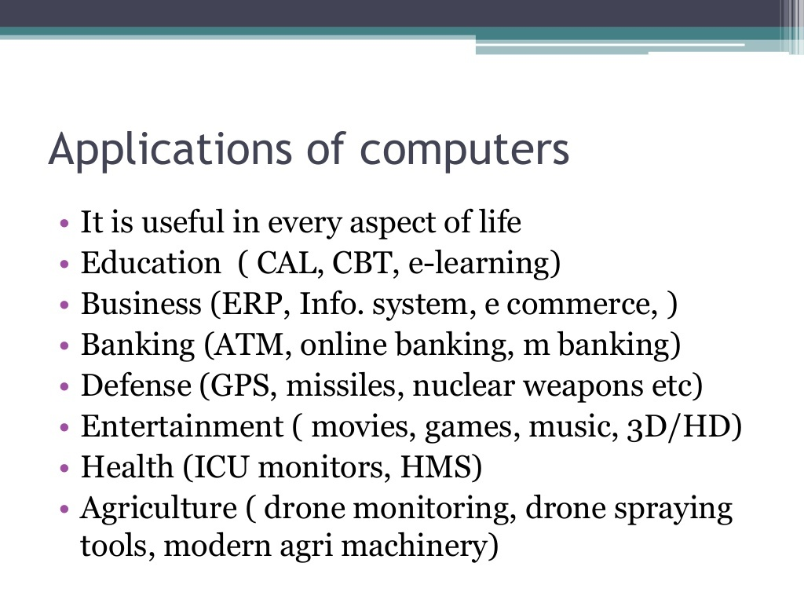

Slide 23
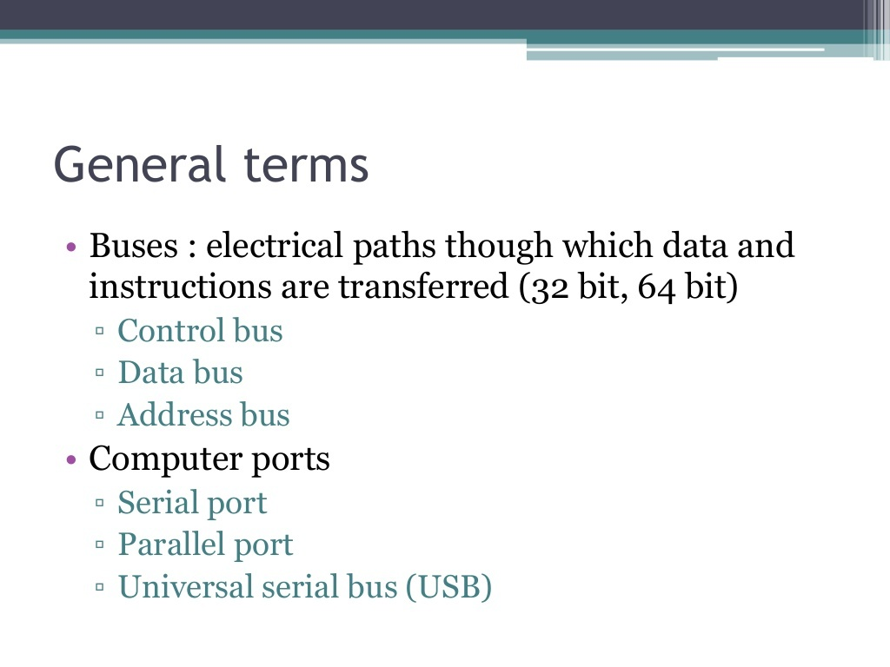

Slide 24
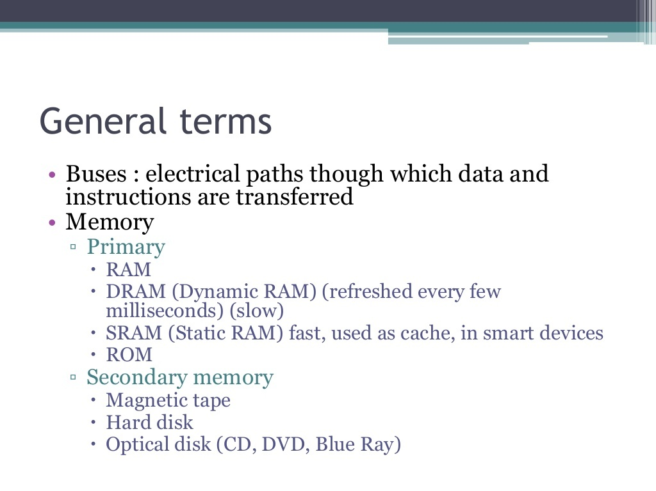

Slide 25
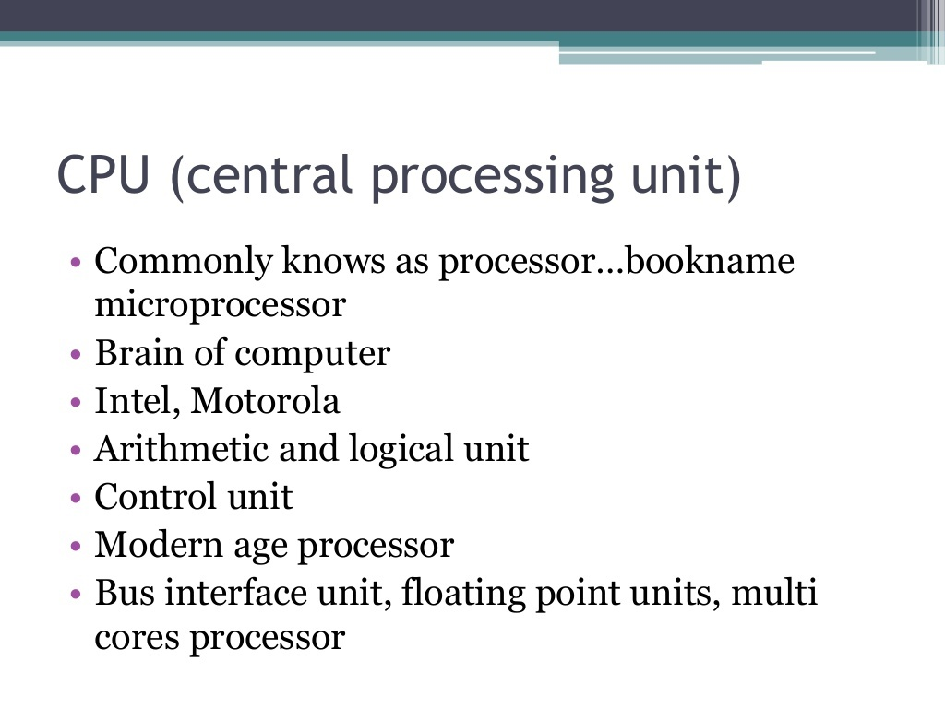

Slide 26
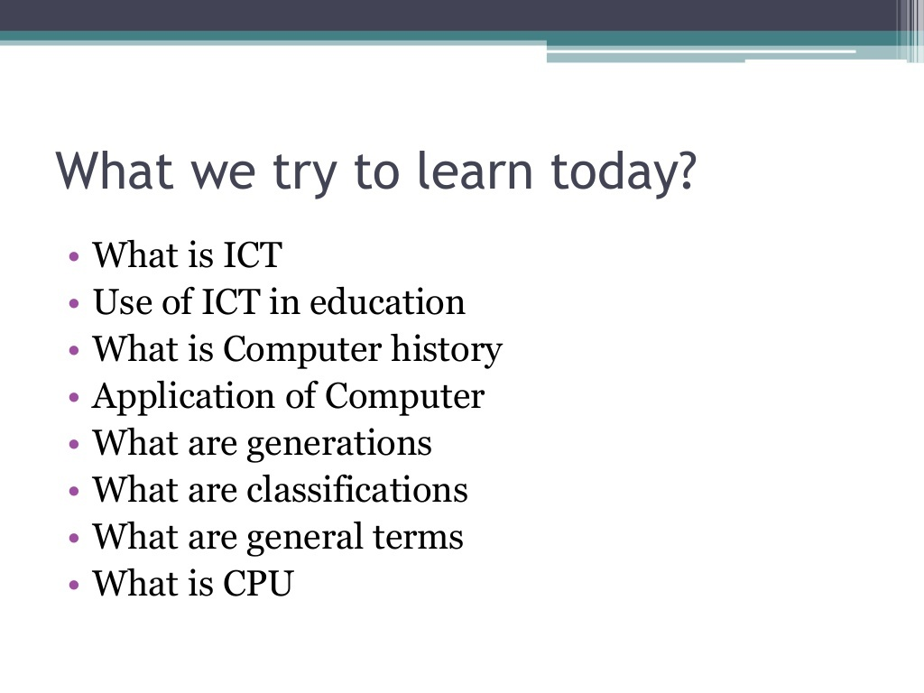

Slide 27
